Slide 1

Big Data Architecture
COMP 1702 Big Data
Lecture 9

Slide 2
Big Data Architecture
Big data architecture is designed to handle ingestion, processing, and analysis of data that is too large or complex for traditional database systems

Slide 3
Types of Workload:
Big Data solutions involve one or more of the following types of workload:
Real time processing of Big Data
Near real-time processing
Batch processing of Big Data
Interactive exploration of Big Data
Predictive analytics & Artificial Intelligence and machine learning

Slide 4
Consider big data architectures when you need to:
Store and process data in volumes too large for a traditional database.
Transform unstructured data for analysis and reporting.
Capture, process, and analyse unbounded streams of data in real time, or with low latency.

Slide 5
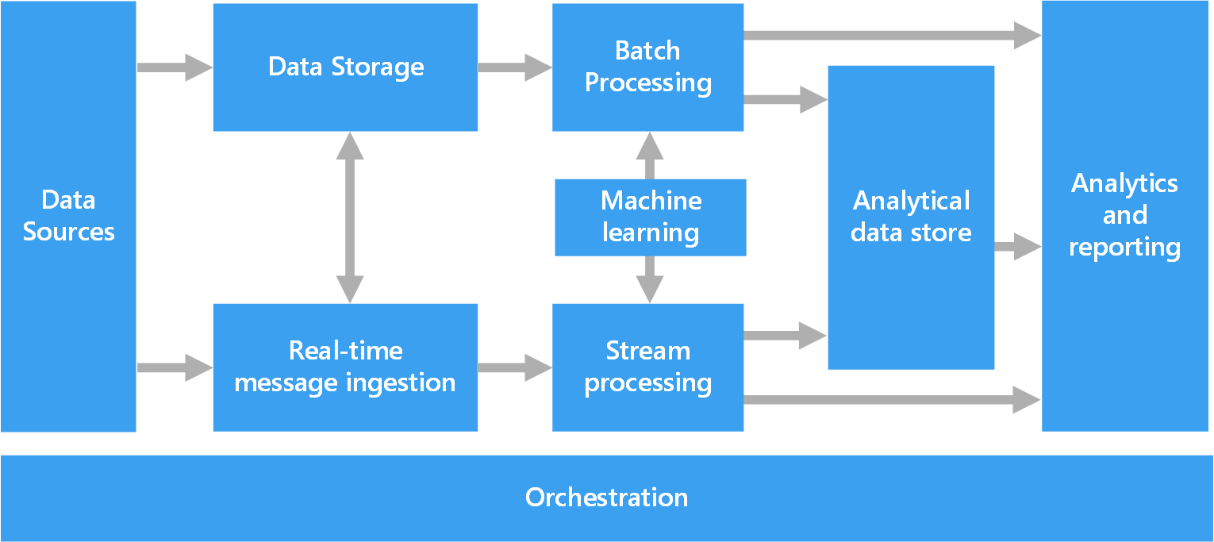
Big Data Architecture - Components

Slide 6
Architecture must be capable of handling Data Sources
There will be one or more data sources and in different formats.
Data can be batch or real time
Data Ingestion in Hadoop usually means ELT (Extract, Load, Transform) rather than ETL (Extract, Transform, Load) as used in traditional Data Warehouse. ELT is better for big data and supports unstructured data better.
Determine frequency at which data would be ingested from each source
Examples include:
Application data stores such as RDBMS
Files produced by applications like web server log files
Real time data sources such as IoT devices or financial market real time prices
Social media

Slide 7
Data cleaning
Data cleaning is the process of identifying and removing (or correcting) inaccurate records from a dataset, table, or database and refers to recognising unfinished, unreliable, inaccurate or non-relevant parts of the data and then restoring, remodelling, or removing the dirty data.
AWS Glue DataBrew is a visual data preparation tool that enables users to clean and normalize data without writing any code.
You can choose from over 250 ready-made transformations to automate data preparation tasks, such as filtering anomalies, converting data to standard formats, and correcting invalid values.
Notes:
.

Slide 8
Data Storage
Need to be able to store very large amounts of data of any format, be scalable and fault tolerant (data lake)
Data is typically stored in a distributed file store (eg Hadoop HDFS) that can hold high volumes of large files in various formats – sequential access
Alternative Data store could be NoSQL database e.g., Apache HBase – random access
Things to consider: Frequency of incoming data, type of data (historical, incremental)
Examples for implementing this storage in the Cloud include Azure Data Lake Store or Amazon AWS EMR

Slide 9
Batch Processing
Because the data sets are so large, big data solution must process data files using batch jobs to filter, aggregate data for advanced analytics.
Usually these jobs involve reading source files, processing them, and writing the output to new files.
Batch processing can be done in various ways by making use of Hive jobs or by making use of Pig complied to Hadoop MapReduce jobs
Using Azure, options can include running U-SQL jobs for unstructured data in Azure Data Lake Analytics
Using Hive in HDInsight Hadoop cluster, or using Java, Scala, or Python code in HDInsight Spark cluster

Slide 10
Real-time processing
Real-time processing typically refers to the reactions to data. A system can be categorized as real-time if it can guarantee that the reaction will be within a tight real-world deadline, usually in a matter of seconds or milliseconds.
It enables businesses to make timely operational decisions that are critical to the success of the organization – while the data is still current.
The architecture needs to capture & store real time messages for stream processing
Incoming messages could be dropped into a simple data store (folder) for processing
Message ingestion store needs to act as a buffer for messages and to support scale out processing and reliable delivery using Publish & Subscribe
This portion of a streaming architecture is often referred to as stream buffering.

Slide 11
Data Ingestion & Apache Flume
Data Ingestion is process by which data is moved from a source(s) to destination where it can be stored and further analysed
Data can be different formats and come from various sources, including RDBMS, CSVs, Social media, etc.
Apache Flume can be used for Data Ingestion; it is a distributed system for aggregating and moving large amounts of streaming data from different sources to a centralised data store
Flume is designed for the continuous ingestion of data into Hadoop HDFS.
Flume is well suited to handling log data like log data from web servers and also used to import huge volumes of event data produced by social media (eg Twitter, Facebook ) and e-commerce websites like Amazon

Slide 12
Messaging using Apache Kafka
Kafka is a messaging system which allow for data to be moved between systems without tight coupling
Is fast, horizontally scalable, durable, distributed by design and fault tolerant
Developed by LinkedIn.
Kafka has better throughput, built-in partitioning, replication and inherent fault-tolerance, which makes it a good fit for large-scale message processing applications and better than other messaging system

Slide 13
Stream Processing
Once the real time messages are captured and delivered, the solution must process them by filtering, aggregating and prepare data for analysis.
Apache Spark Streaming is often used to implement stream processing
Azure Stream Analytics provides a managed stream processing service based on perpetually running SQL queries that operate on unbounded streams
Apache Kafka KSQL also provides the ability to continuously query streams of Data
You can also use open source Apache streaming technologies like Spark Streaming in an Azure HDInsight cluster

Slide 14
Analytical Data Store
Many big data solutions prepare data for analysis and then serve the processed data in a structured format that can be queried using analytical tools.
The analytical data store used to serve these queries can be a relational data warehouse, like traditional business intelligence (BI) solutions.
Alternatively, the data could be presented through a low-latency NoSQL technology such as HBase, or an interactive Hive database that provides a metadata abstraction over data files in the distributed data store.
Azure Synapse Analytics provides a managed service for large-scale, cloud-based data warehousing. HDInsight supports Interactive Hive, HBase, and Spark SQL, which can also be used to serve data for analysis.

Slide 15
Analysis & Reporting
The goal of most big data solutions is to provide insights into the data through analysis and reporting.
To let users to analyse the data, the architecture may include a data modelling layer
It might also support self-service BI, using the modelling and visualisation technologies in Microsoft Power BI or Microsoft Excel.
Analysis and reporting can also take the form of interactive data exploration by data scientists or data analysts.
MS Azure supports for analytical notebooks, such as Jupyter, enabling these users to leverage their existing skills with Python or R.
For large-scale data exploration, you can use Microsoft R Server, either standalone or with Spark

Slide 16
Orchestration/Automation
Big data based solutions consist of data related operations that are repetitive in nature
It consists of repeated data processing operations, workflows that transform source data, move data between multiple sources and sinks, load the processed data into an analytical data store or push the result to a report or dashboard
Moving the data through these various systems requires orchestration.
To automate these workflows, you can use an orchestration technology such as Azure Data Factory or Apache Oozie

Slide 17
Big Data - Best Practice (I)
Leverage parallelism - Big data processing technologies distribute the workload across multiple nodes (processing units). Distributed file systems, like HDFS can optimise read and write performance, and the actual processing is performed by multiple cluster nodes in parallel – Blocks - which reduces overall job times
Partition data. It is desirable to divide data into related parts based on the values of partitioned columns such as date, city, and department. F.g, partitioning tables that are used in Hive can improve query performance.

Slide 18
Big Data - Best Practice (II)
Apply schema-on-read semantics - Apply a schema onto the data when the data is processed (NOT when it is stored). This builds flexibility and prevents bottlenecks during data ingestion caused by data validation, type checking
Process data in-place. Traditional BI solutions use Extract, Transform Load (ETL) process to move data into data warehouse. To support larger volumes data and greater variety of formats, big data solutions use variations of ETL, such as transform, extract, and load (TEL). With this approach, the data is processed within the distributed data store, transforming it to the required structure, before moving the transformed data into an analytical data store.
Notes:
customer data

Slide 19
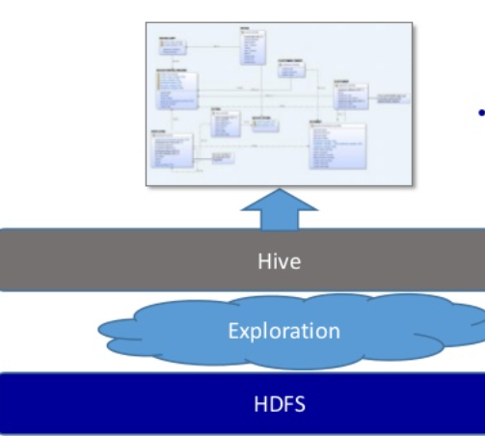
Big Data Model – Schema on Read
It means you will not need to know how you will use data when you store data
Don’t need to know exactly how you will use the data
Eg first place data on Hadoop HDFS and then apply table structure using Apache Hive
Hive provides a mechanism to structure data in Hadoop HDFS and to issue SQL like dialect

Slide 20
Data Ingestion & Apache Flume
Data Ingestion is process by which data is moved from a source(s) to destination where it can be stored and further analysed
Data can be different formats and come from various sources, including RDBMS, CSVs, Social media, etc.
Apache Flume can be used for Data Ingestion; it is a distributed system for aggregating and moving large amounts of streaming data from different sources to a centralised data store, like HDFS
Flume is designed for the continuous ingestion of data into Hadoop HDFS.
Flume is well suited to handling log data from web servers and also used to import huge volumes of event data produced by social media (eg Twitter, Facebook ) and e-commerce websites like Amazon

Slide 21
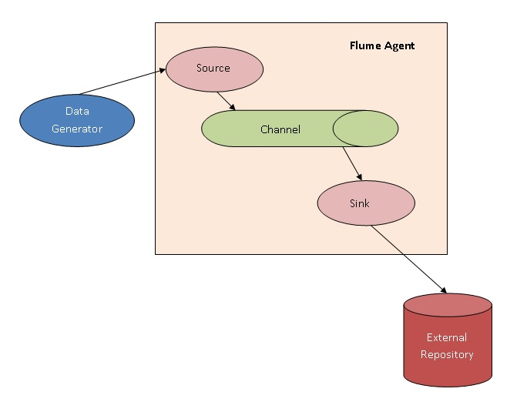
Apache Flume Architecture
Data Generator
A data generator is any data feed; such as Twitter, Facebook that creates data to be collected by the Flume Agent
Flume Agent: each agent has three components: sources, channels, and sinks.
Source
Source component receives data from the data generators and transfers it to one or more channels in the form of Flume events
Channel
A channel is a transient store which receives Flume events from the source and buffers them till they are consumed by sinks
Sink
A sink consumes Flume events from the channels and delivers it to the destination. The destination of the sink may be another agent or an external repository; such as, HDFS

Slide 22
What is Apache Sqoop (SQL-to-Hadoop)
Used for transferring data between Hadoop (HDFS, HBase) and relational database servers (eg Oracle, MS SQL server, MySql, Postgress)
Works Both ways i.e. we can use Sqoop to transform the data in Hadoop and then export the data back into an RDBMS
Sqoop uses Mapreduce to import and export the data (no need to write complex MapReduce programs to use parallel distributed processing)
Provides Command Line interface for importing or exporting data

Slide 23
Flume Vs Sqoop
Flume ingest streaming data source, which can be unstructured, semi-structured data into Hadoop HDFS. Data can be from logs, JMS (Java Message Service), etc.
Sqoop can import/export structured data from RDBMS or Enterprise data warehouses to HDFS or vice versa
Flume is event driven while Sqoop is not event driven

Slide 24
Messaging using Apache Kafka - Introduction
Kafka is a a scalable and efficient messaging system for collecting various user activity events and log data, developed by LinkedIn.
Kafka is fast, horizontally scalable, durable, distributed by design and fault tolerant. Kafta is faster than Flume
Kafka has better throughput, built-in partitioning, replication and inherent fault-tolerance, which makes it a good fit for large-scale message processing applications and better than other messaging system.
It is a general purpose tool for multiple producers and consumers (Unlike Apache flume which is specific purpose: collecting log data from various web servers to HDFS).

Slide 25
Take a step back – what is a messaging system
Messaging System is responsible for transferring data from one application to another so the applications can focus on what it needs to do and not worry about how to share it
Distributed messaging is based on the concept of reliable message queuing
Messages are queued asynchronously between client applications and messaging system
2 types of messaging patterns are popular − point to point and publish subscribe (pub-sub).
Most of the messaging patterns follow pub-sub.

Slide 26
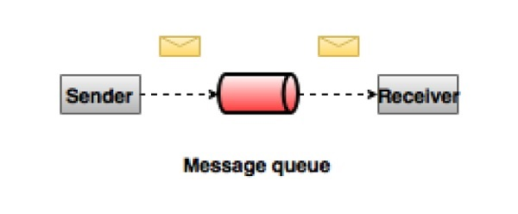
Point to Point Messaging
Messages are persisted in a queue & acknowledged receiver
A particular message can be consumed by a maximum of one consumer only – one to one
Pull based model
Once a consumer reads a message in the queue it disappears from that queue. Not Scalable.

Slide 27
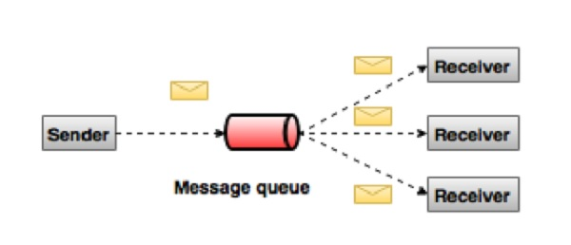
Publish-subscribe model
In publish-subscribe (pub-sub) system messages are persisted in topic
Unlike point-to-point system consumers can subscribe one or more topic and consume all the messages
in that topic i.e. one to many
More scalable and loose coupling
Analogy – tuning into a radio station

Slide 28
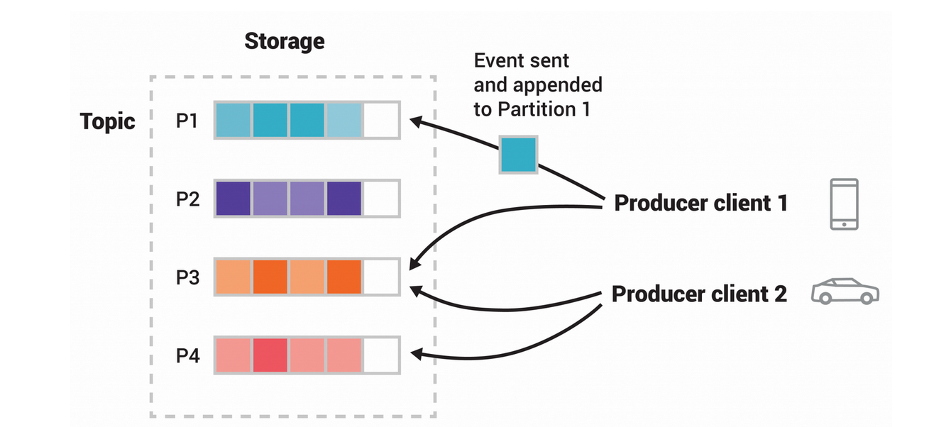
Kafka Messaging System Example
Two different producer clients are publishing
This example topic has four partitions P1–P4.
Events with the same key (denoted by their colour in the figure) are written to the same partition
Note that both producers can write to the same partition if appropriate.
Notes:
.

Slide 29
Kafka Benefits
Reliability − distributed, partitioned, replicated and fault tolerance.
Scalability − scales easily without down time
Durability − Uses Distributed commit log which means messages persists on disk as fast as possible and durable
Performance − Kafka has high throughput for both publishing and subscribing messages.
Kafka is very fast and guarantees zero downtime and zero data loss

Slide 30
Kafka high level overview
Unified platform for handling all the real-time data feeds.
Supports low latency message delivery and gives guarantee for fault tolerance
It has the ability to handle a large number of diverse consumers
A message is simple key/value pair
Event key: "Alice"
Event value: "Made a payment of $200 to Bob"
Event timestamp: "Jun. 25, 2020 at 2:06 p.m."
Is very fast, performs 2 million writes/sec – it persists all data to the disk, all the writes go to the page cache of the OS. This makes it very efficient to transfer data from page cache to a network socket

Slide 31
Example of Kafka usages
Stream Processing − Frameworks such as Spark Streaming read data from a topic, processes it, and write processed data to a new topic where it becomes available for users and applications.
KSQL provides the ability to continuously query infinite streams of Data using SQL like dialect
Log Aggregation Solution − can be used across organisation to collect logs from multiple services and make them available in a standard format to multiple consumers
Metrics − used for operational monitoring data. This involves aggregating statistics from distributed applications to produce centralised feeds of operational data

Slide 32
Application usage of Kafka
Twitter uses Kafka to send and receive users tweets. Registered users can read and post tweets but unregistered users can only read tweets
LinkedIn uses Kafka for activity stream data and operational metrics. There are several products like LinkedIn Newsfeed, LinkedIn Today, for online message consumption and in addition to offline analytics systems like Hadoop Kafka messaging system helps LinkedIn

Slide 33
Orchestration: Apache Oozie – Hadoop Scheduler
Oozie enables orchestration and scheduling of hadoop jobs
Oozie is a workflow scheduler system to manage & execute Hadoop jobs in distributed environment
It is tightly integrated with Hadoop stack supporting various Hadoop jobs like Hive, Sqoop, Pig as well as system specific jobs like Java and Shell
Oozie is scalable and can manage the timely execution of thousands of workflows, each consisting of dozens of jobs
Responsible for triggering the workflow actions, which in turn uses the Hadoop execution engine to execute the task

Slide 34
Oozie Details
Three types of Jobs in Oozie
Oozie Workflow Jobs − Sequence of actions to be performed are represented as Directed Acyclic Graphs (DAGs)
Oozie Coordinator Jobs − Consists of workflow jobs triggered by time and data availability
Oozie Bundle − These can be referred to as a package of multiple Coordinator and Workflow jobs

Slide 35


Classwork
Develop a high level architecture for fraud detection in credit card. The application needs to be near real time and the number of credit card users are approximately 100 million.
There is also a need to do exploratory analysis to better understand credit card fraud trends and this functionality does not have real time performance.

Slide 36
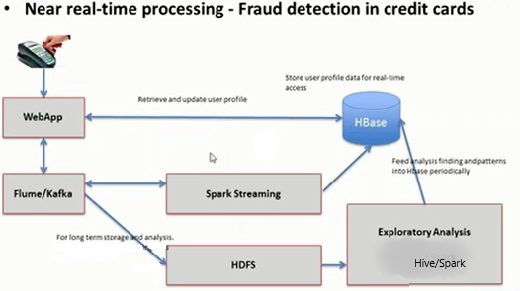
Example – Sample Architecture

Slide 37
Thanks！

